Slide 1
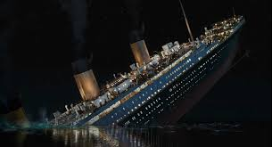

Titanic survival prediction
Using naïve bayes classifier
Mounika Maddu

Slide 2
Problem Statement:
Titanic dataset Analysis
On April 15, 1912, during her maiden voyage, the Titanic sank after colliding with an iceberg, killing 1502 out of 2224 passengers and crew. Translated 32% survival rate.
One of the reasons that the shipwreck led to such loss of life was that there were not enough lifeboats for the passengers and crew.
Although there was some element of luck involved in surviving the sinking, some groups of people were more likely to survive than others, such as women, children, and the upper-class.

Slide 3
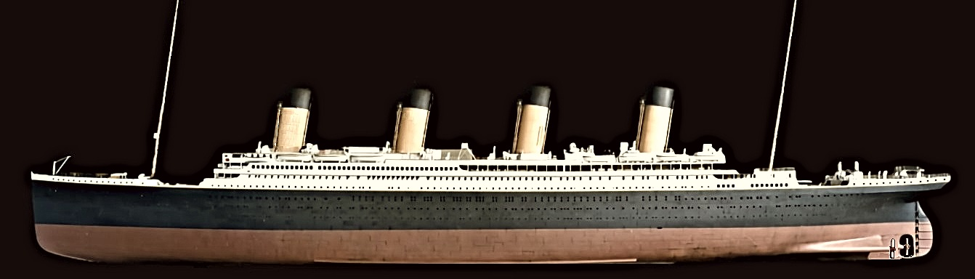
Dataset Information
The data has been split into two groups:
training set (train.csv)
test set (test.csv)

Slide 4
The training set should be used to build your machine learning models. For the training set, we provide the outcome (also known as the “ground truth”) for each passenger. Your model will be based on “features” like passengers’ gender and class. You can also use feature engineering to create new features.
The test set should be used to see how well your model performs on unseen data. For the test set, we do not provide the ground truth for each passenger. It is your job to predict these outcomes. For each passenger in the test set, use the model you trained to predict whether or not they survived the sinking of the Titanic.
We also include gender_submission.csv, a set of predictions that assume all and only female passengers survive, as an example of what a submission file should look like.

Slide 5
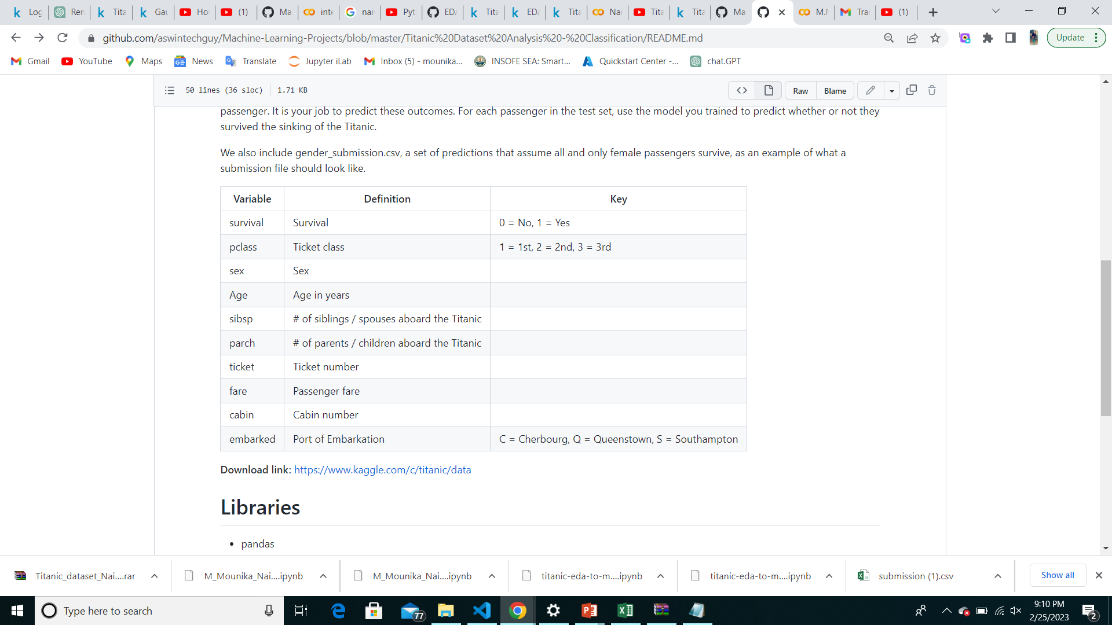
The attribute description of this dataset is given bellow :

Slide 6
Variable Notes
Pclass : A proxy for socio-economic status (SES) 1st = Upper 2nd = Middle 3rd = Lower age : Age is fractional if less than 1. If the age is estimated, is it in the form of xx.5 sibsp :The dataset defines family relations in this way... Sibling = brother, sister, stepbrother, stepsister Spouse = husband, wife (mistresses and fiancés were ignored) parch : The dataset defines family relations in this way... Parent = mother, father Child = daughter, son, stepdaughter, stepson Some children travelled only with a nanny, therefore parch=0 for them.

Slide 7
Implementation
Importing the necessary libraries
Importing the dataset
Read and explore the data
Data visualization
Cleaning the analyzing the datset
Checking the null values

Slide 8
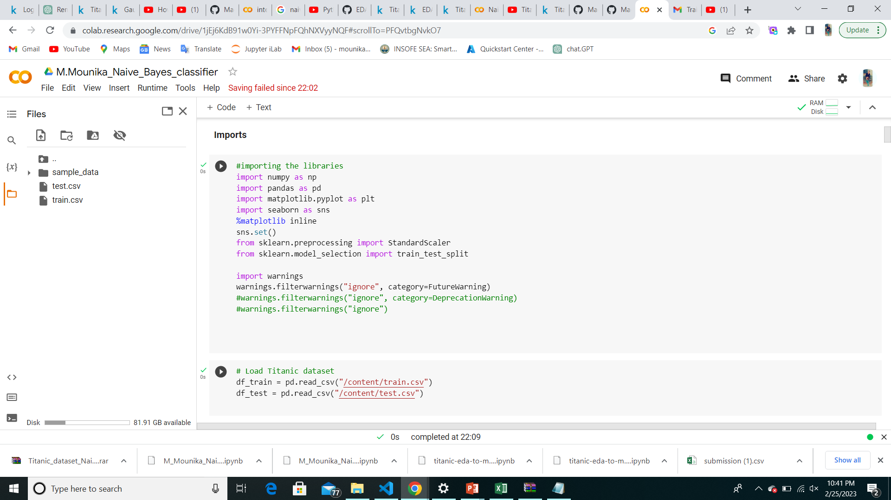
Importing the necessary libraries

Slide 9
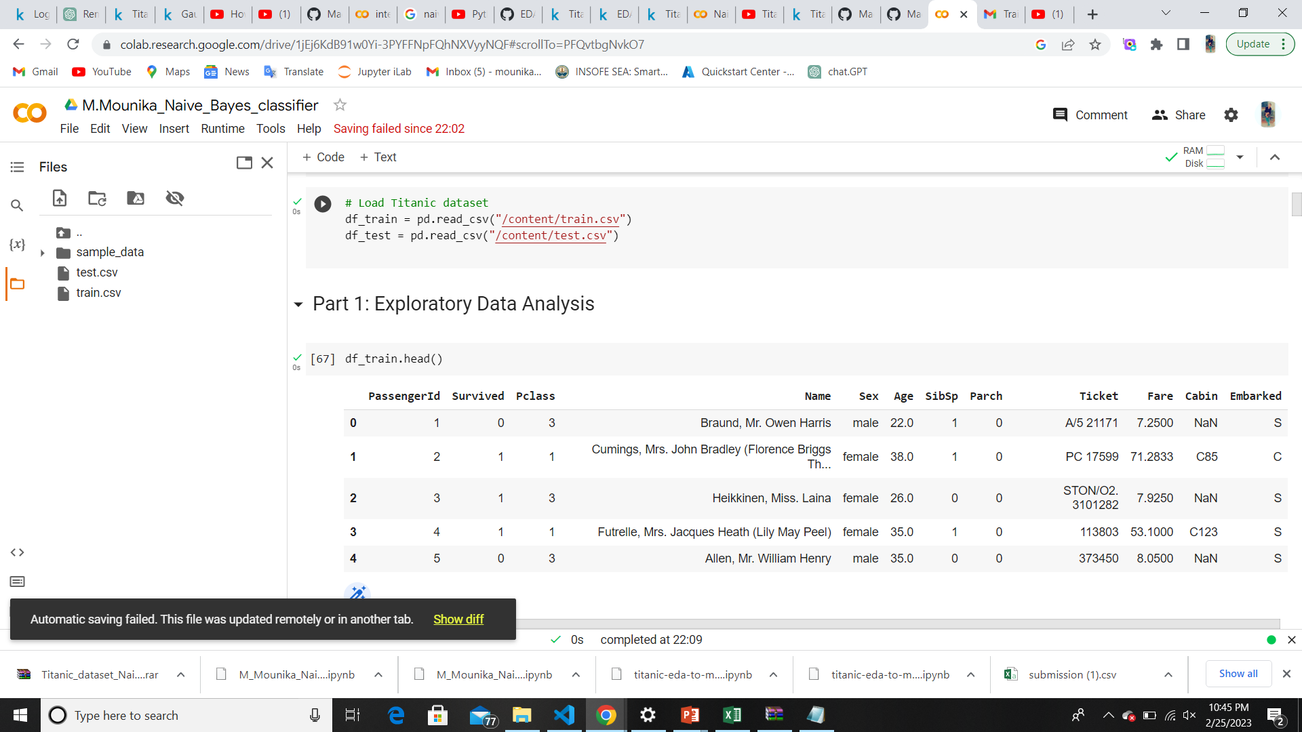
Read and explore the data

Slide 10
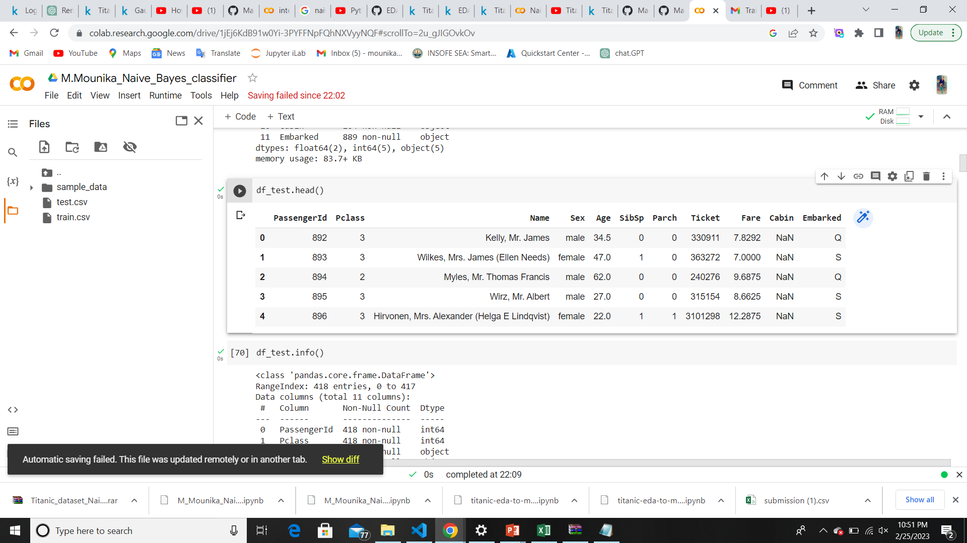
Traning Set : 891 Rows
Testing Set : 418 Rows

Slide 11
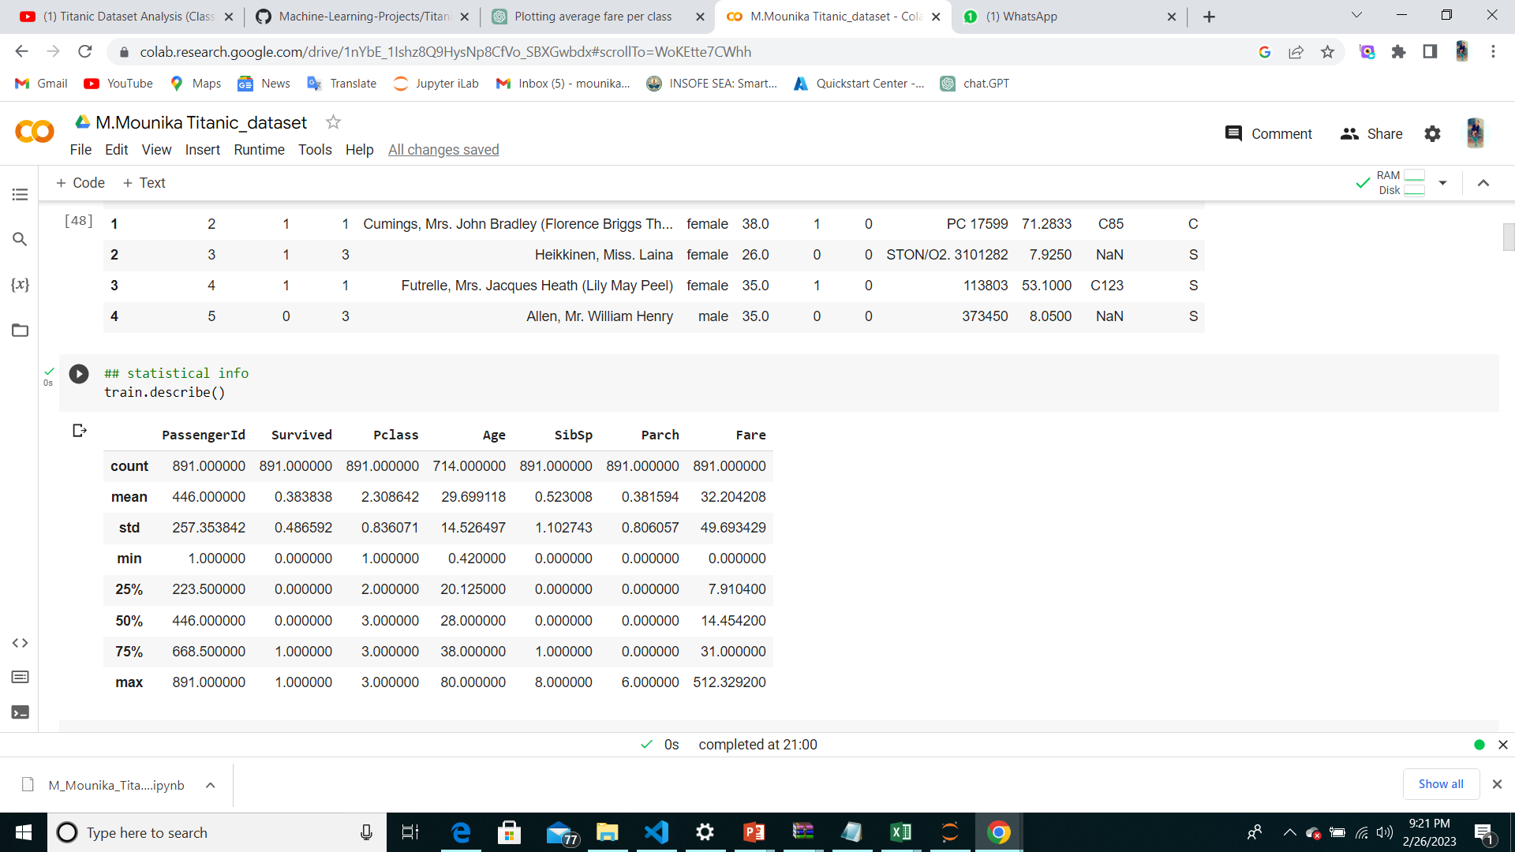
Exploratory Data Analysis

Slide 12
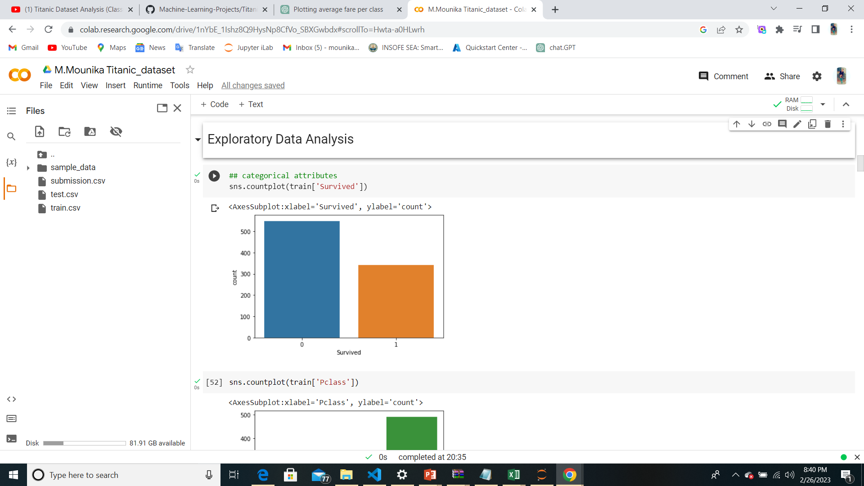
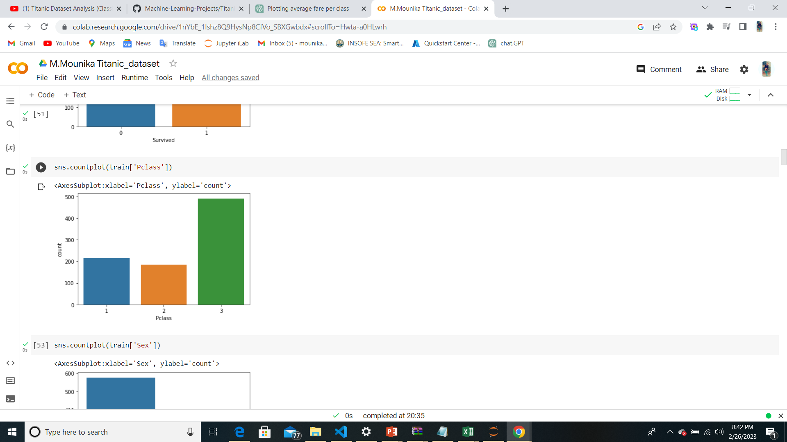
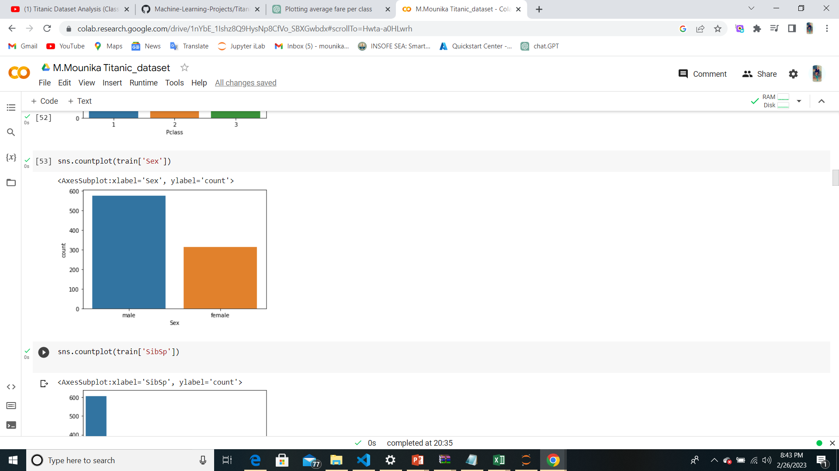
Categorical Attributes

Slide 13
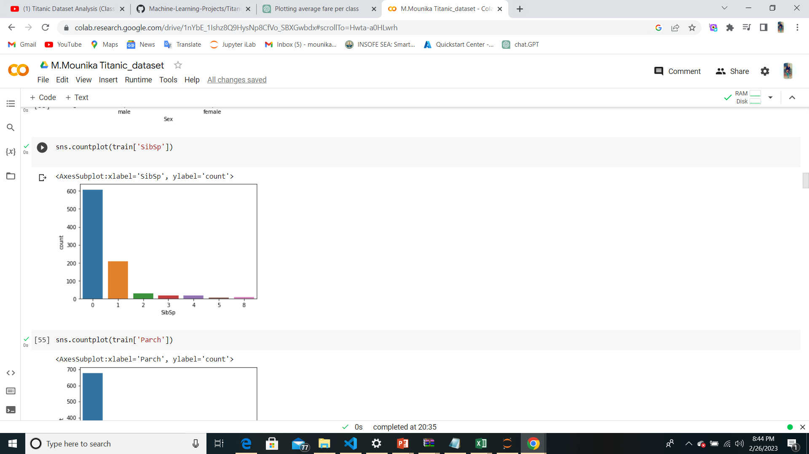
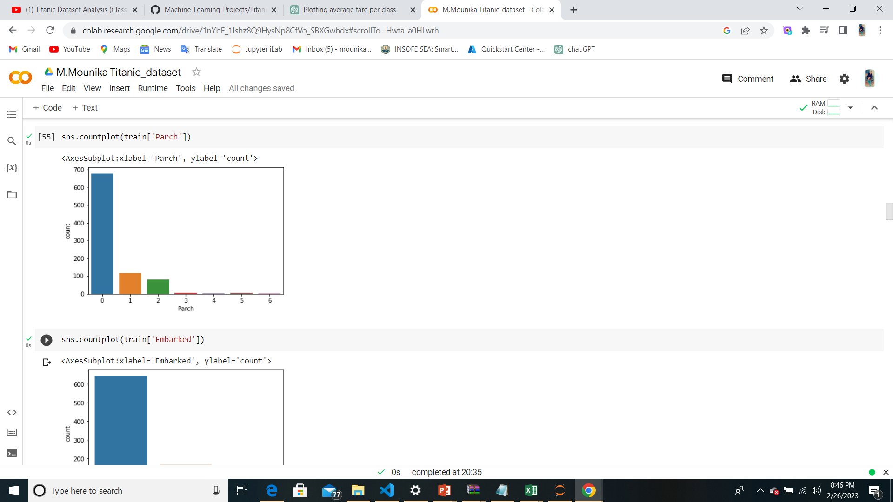
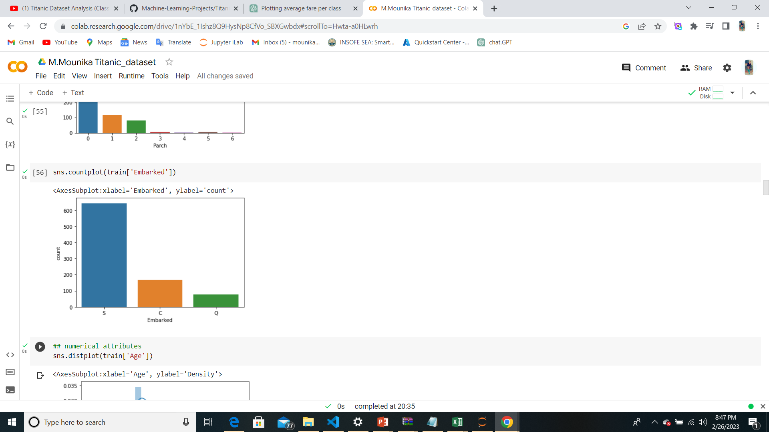

Slide 14
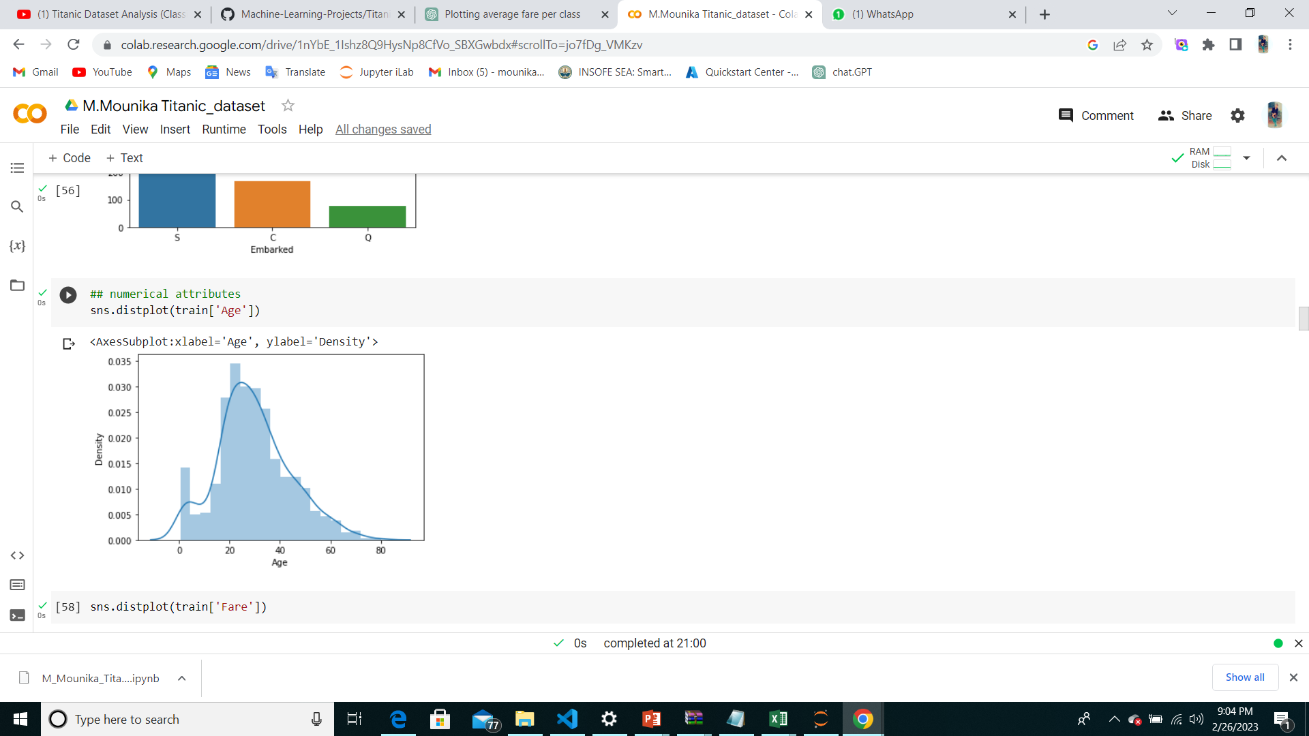
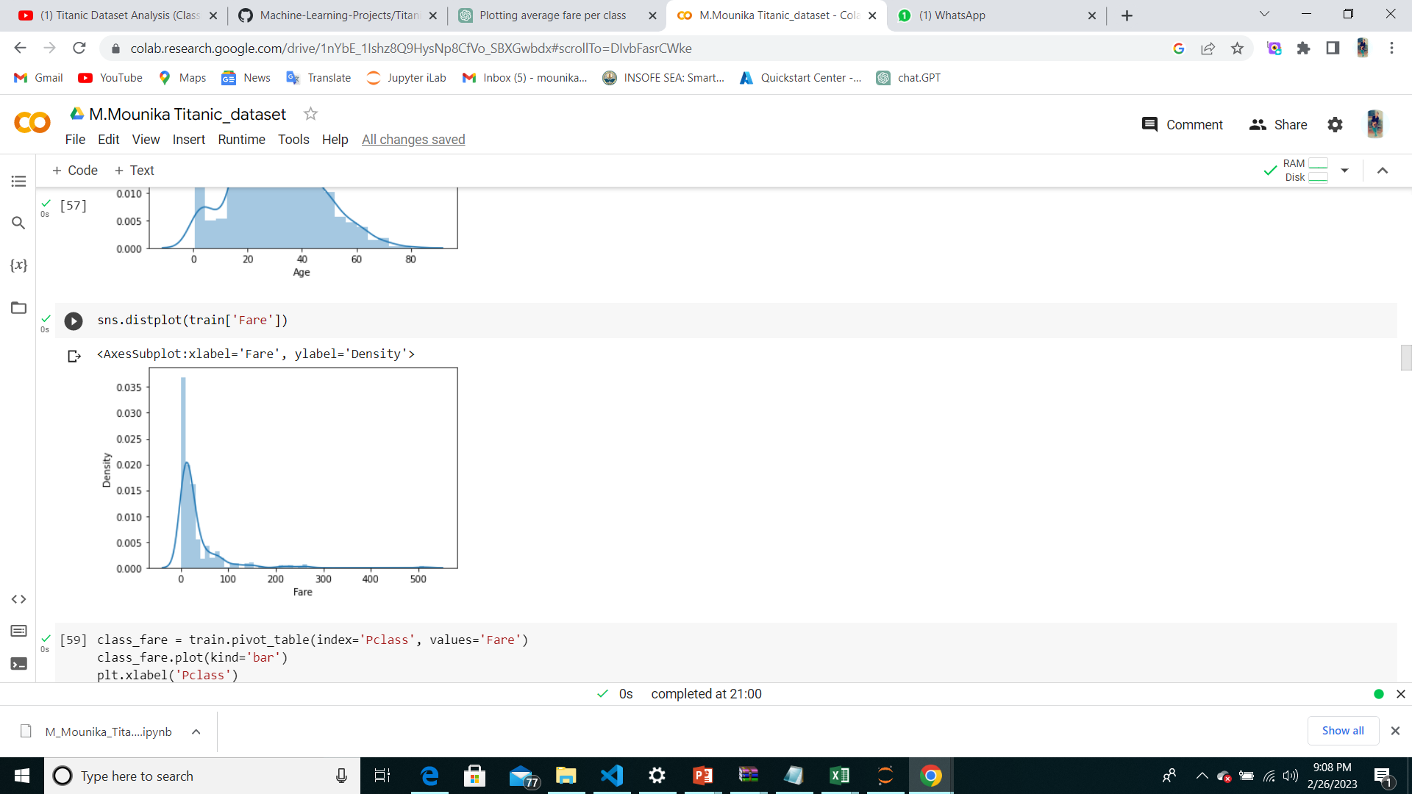
Numerical Attributes

Slide 15
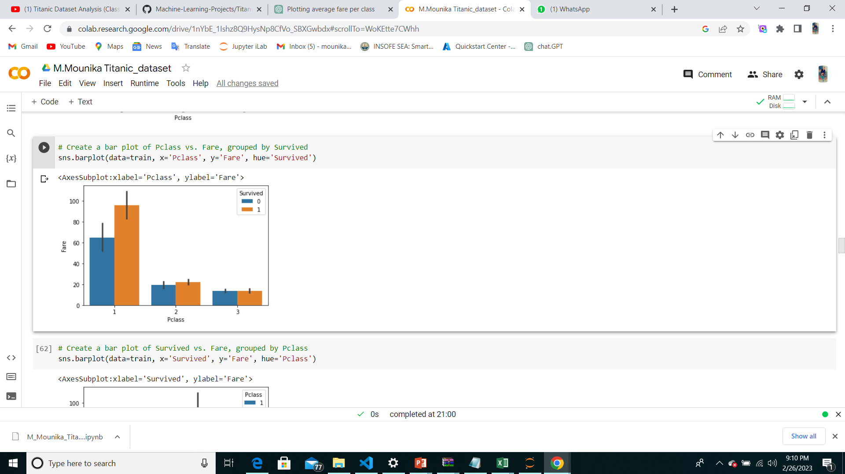
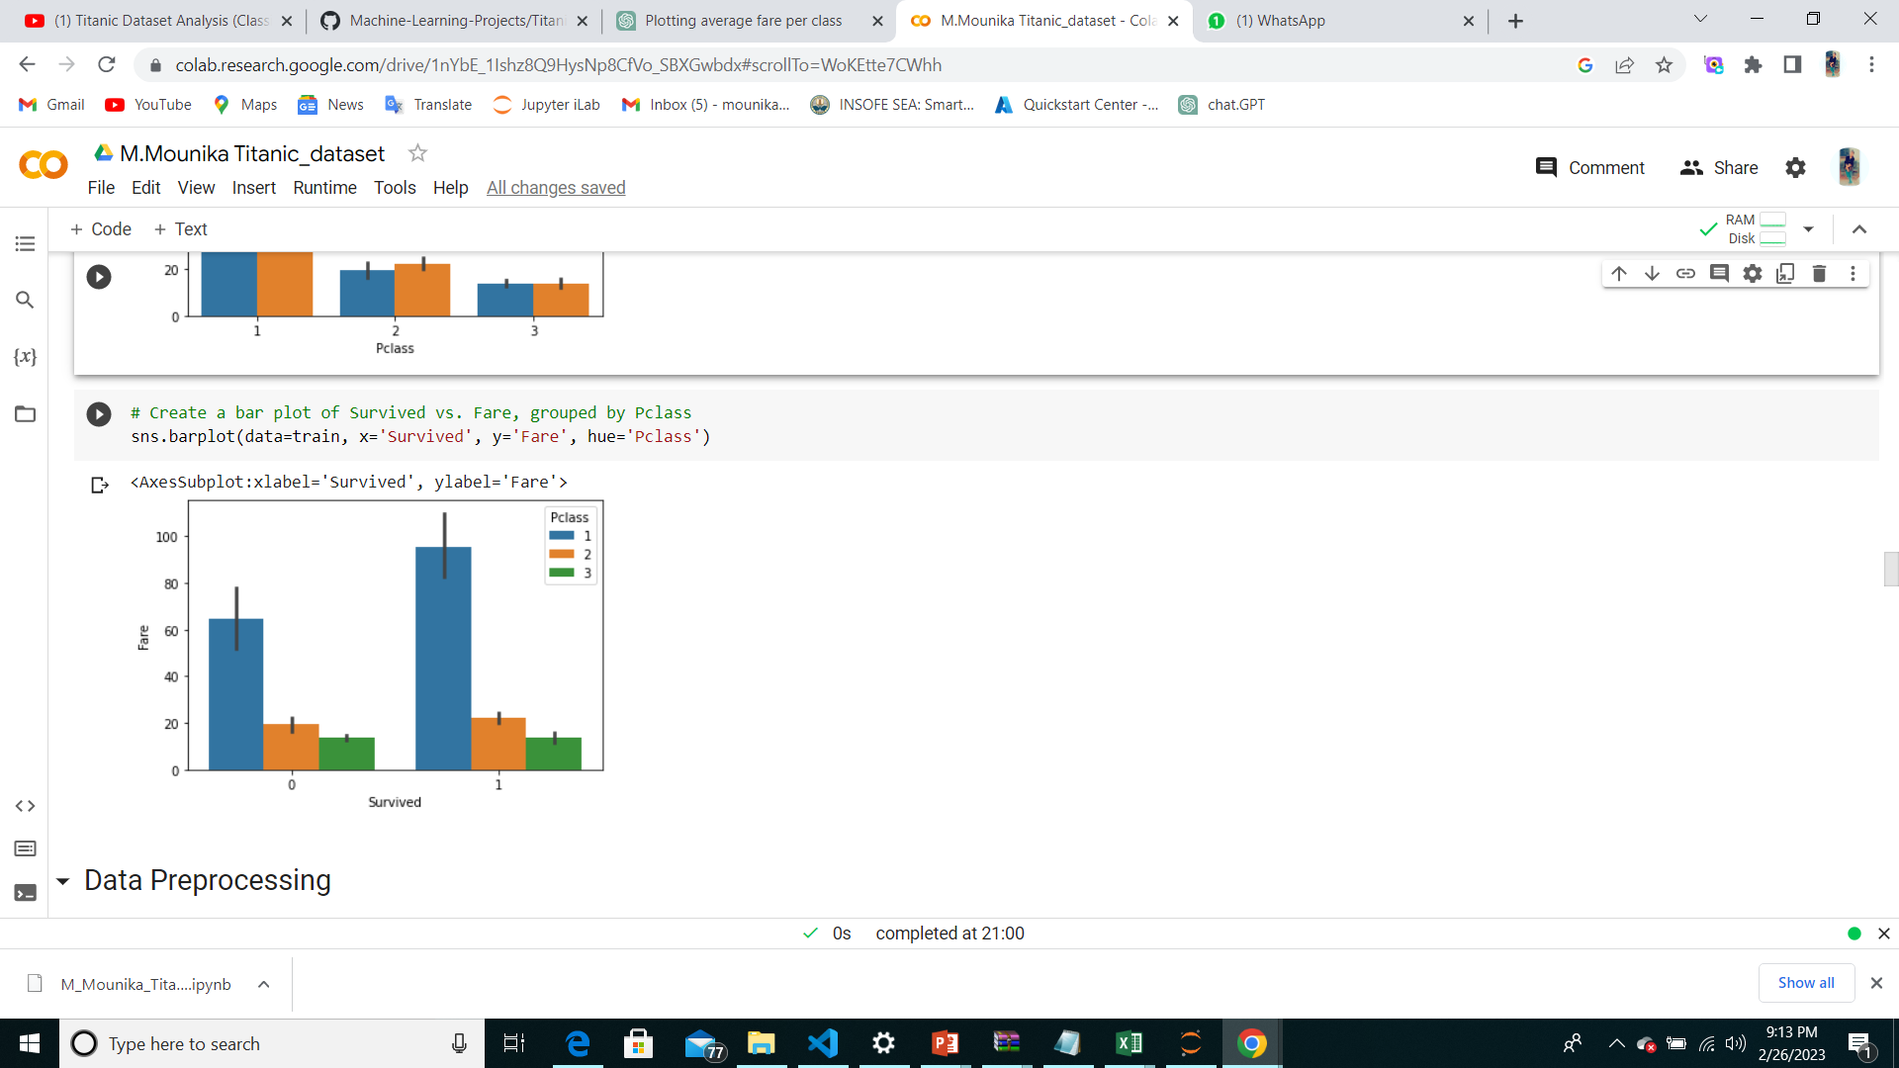
Data visualization
Seeing how independent variables are effecting survival
Pclass Feature :
Survived Feature :

Slide 16
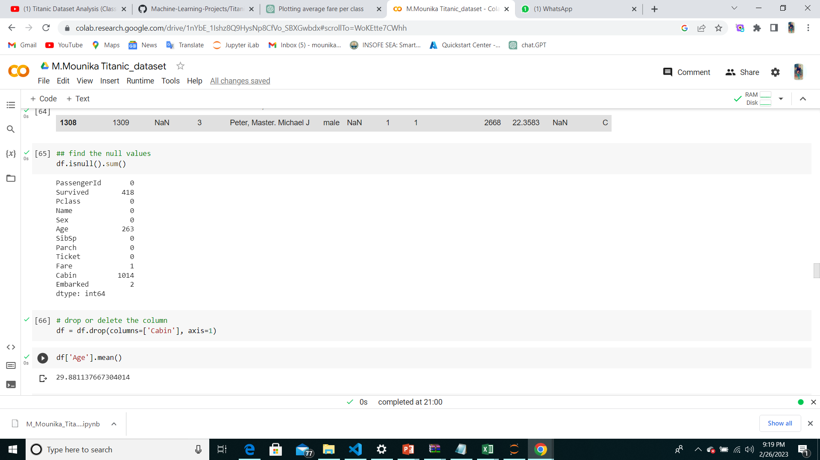
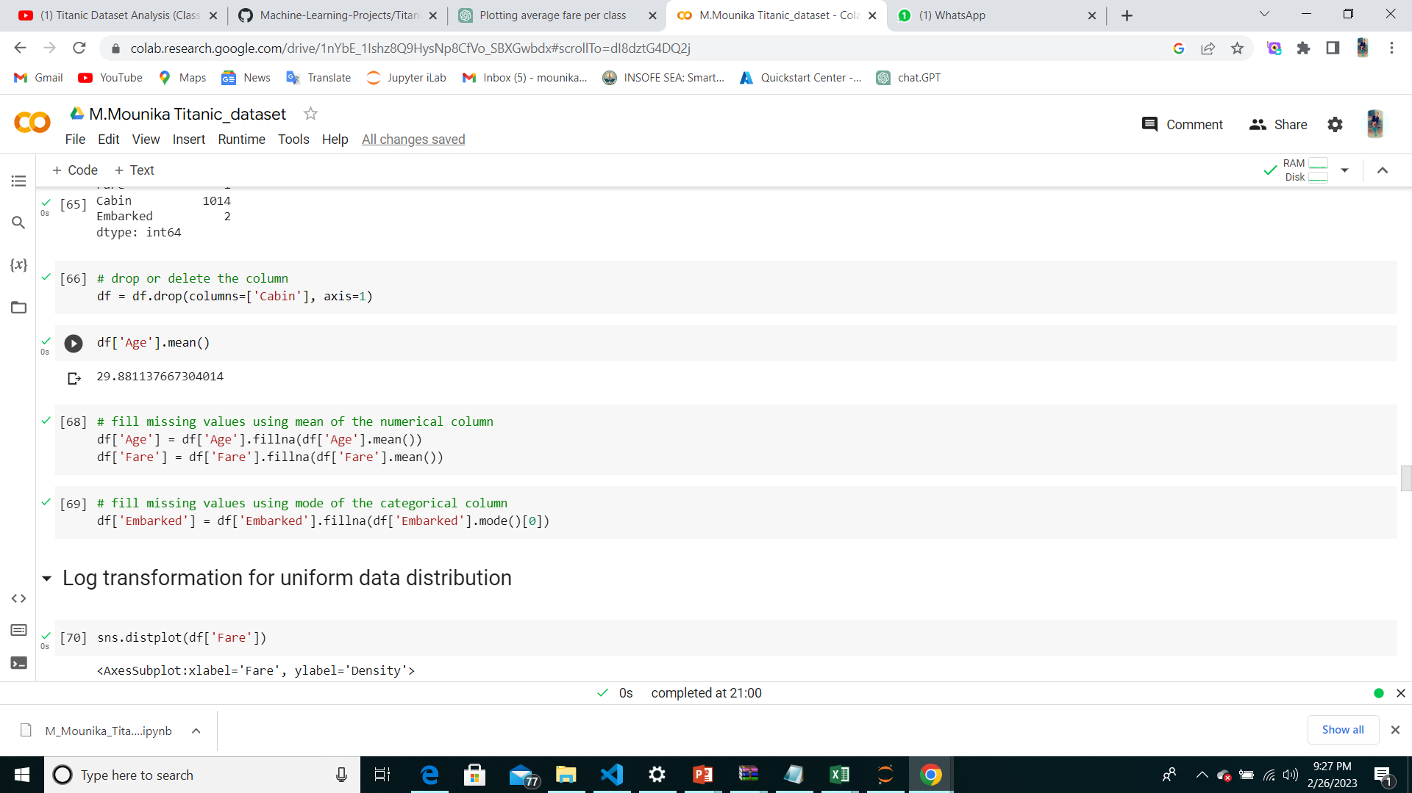
Cleaning and analyzing the data
Check for null values in the dataframe
drop the unnecessary columns

Slide 17
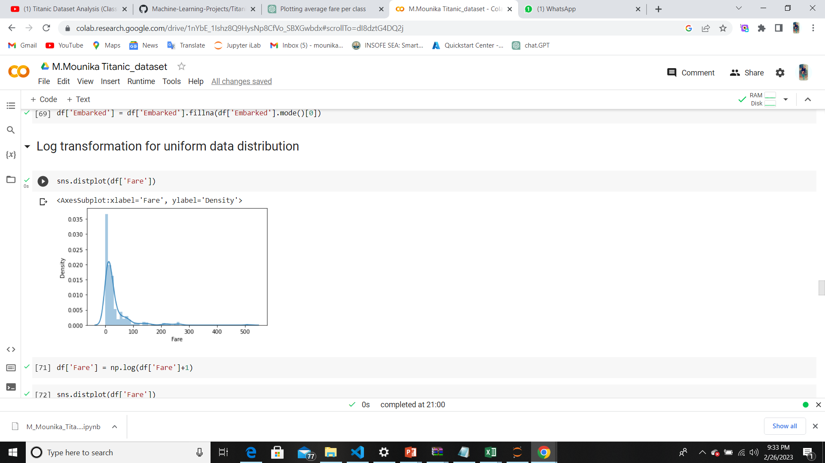
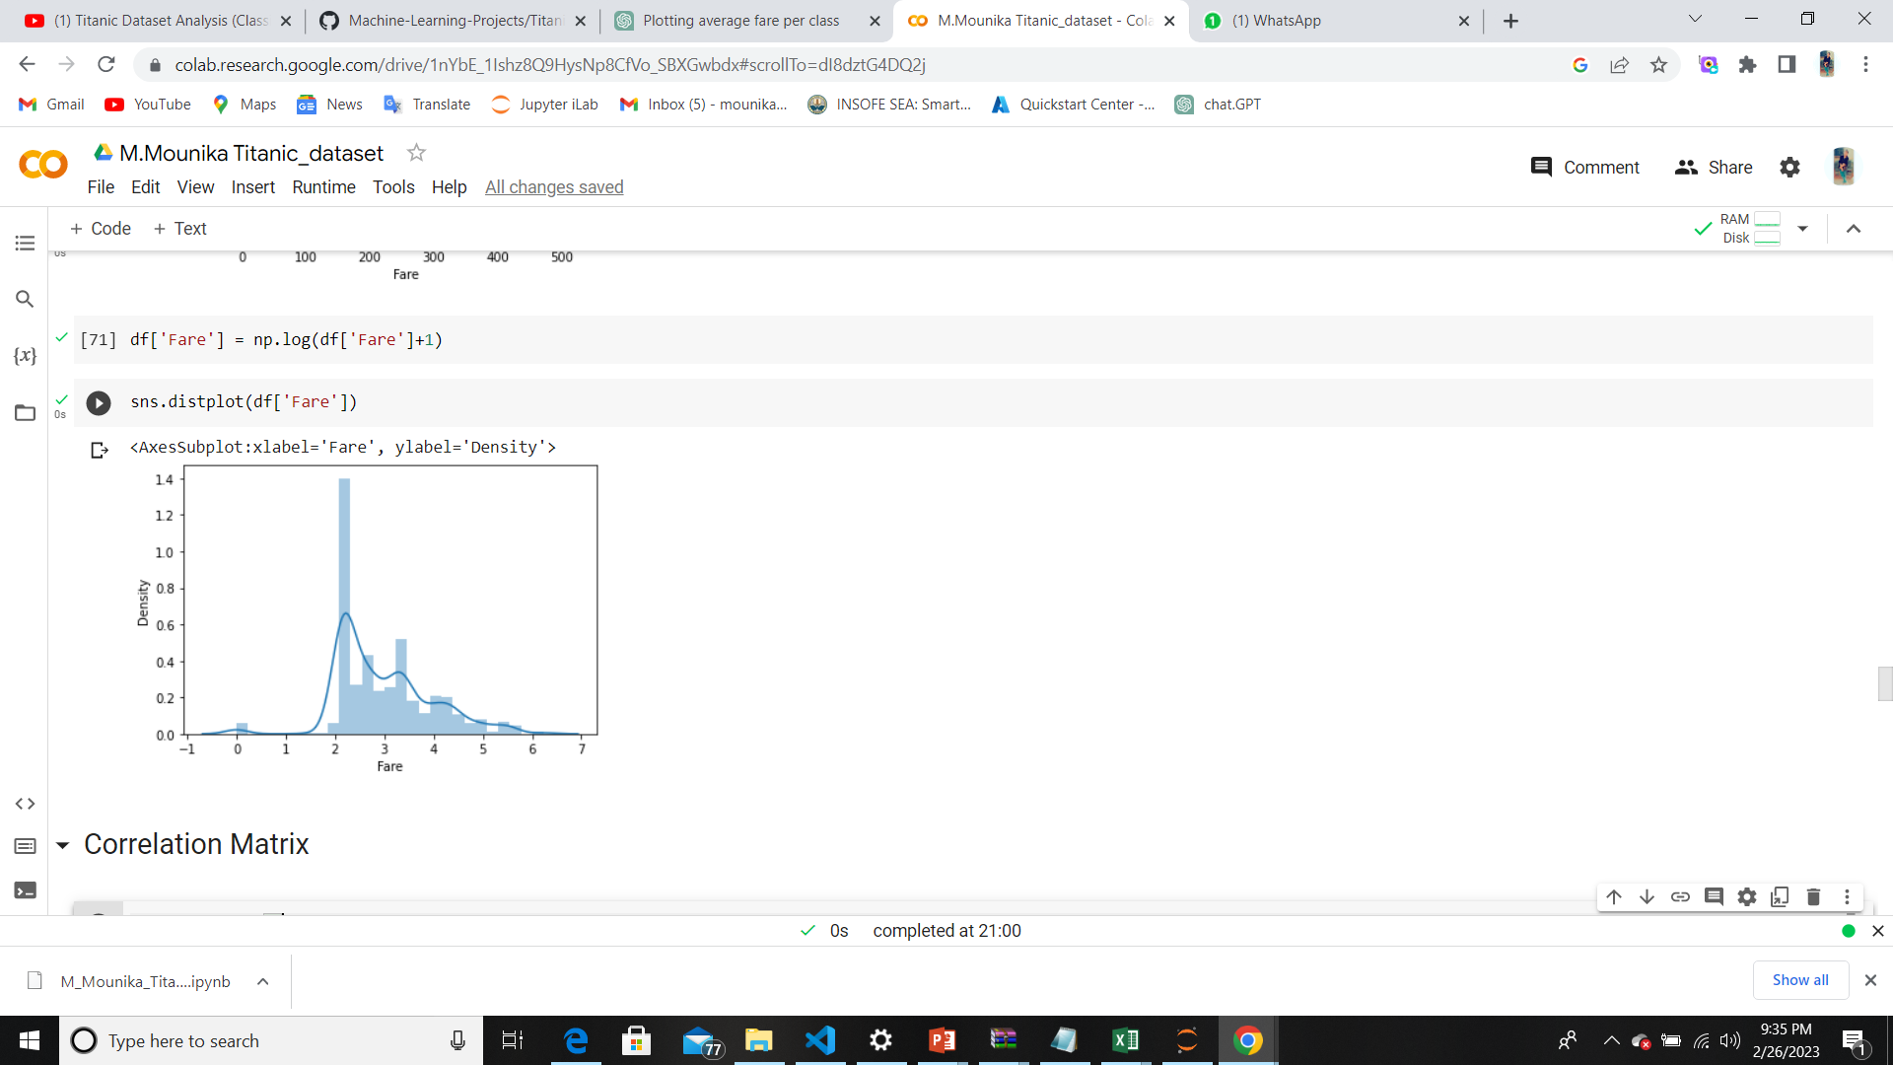
Log transformation for uniform data distribution
compare the two plots changing the before and after

Slide 18
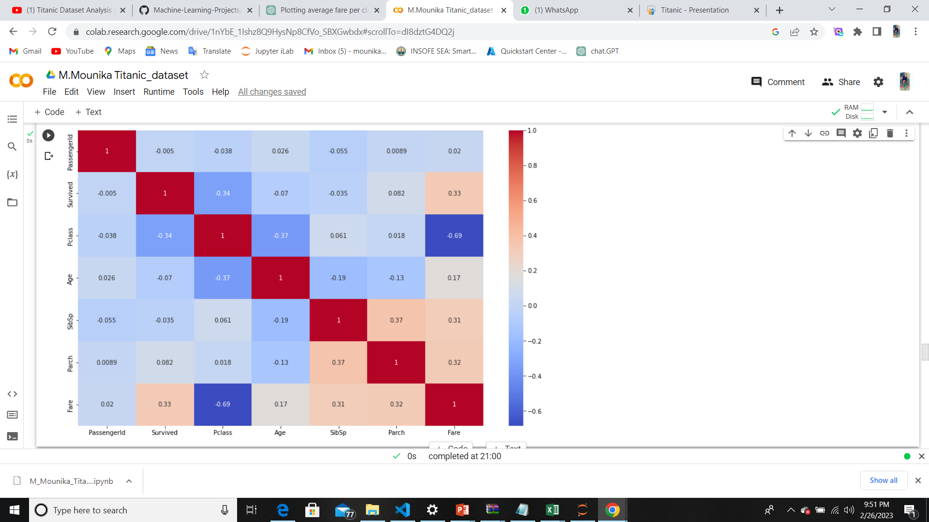
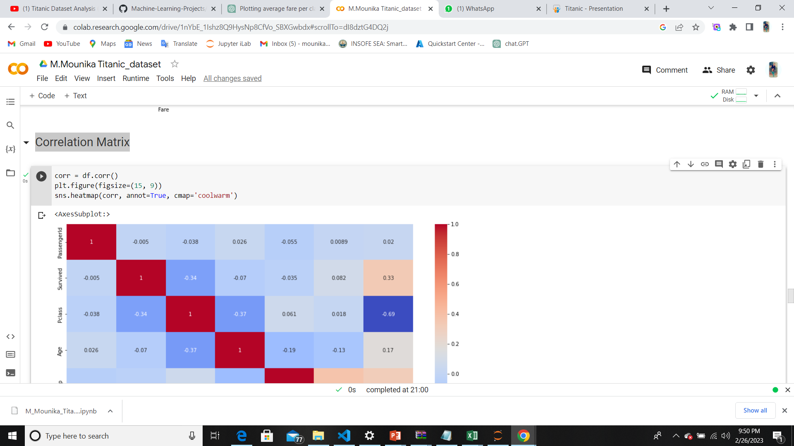
Correlation Matrix

Slide 19
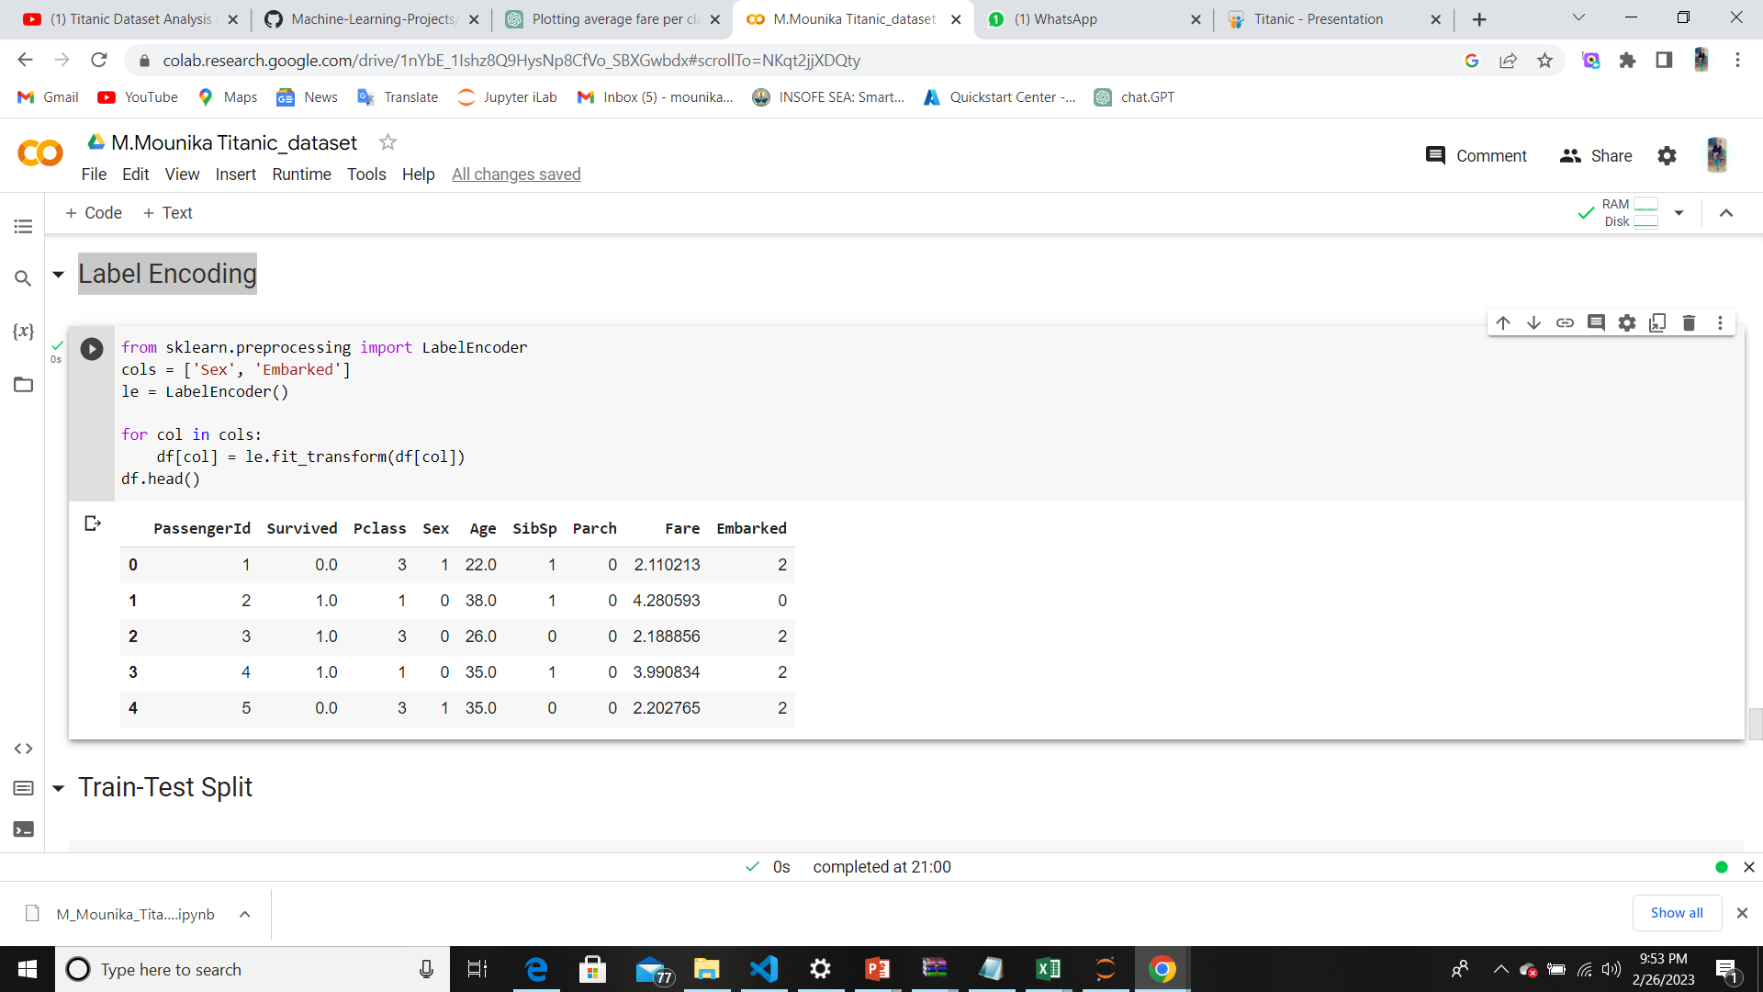
Label Encoding

Slide 20
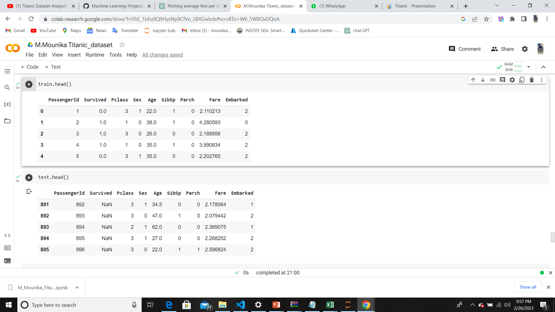
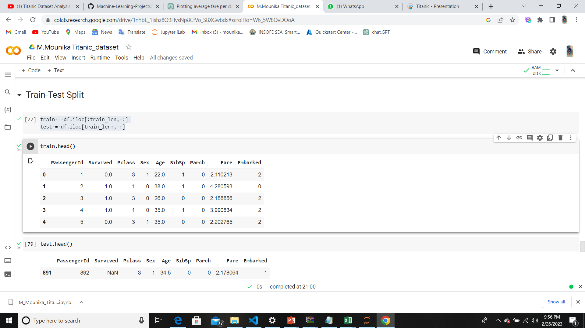
Train-Test Split

Slide 21
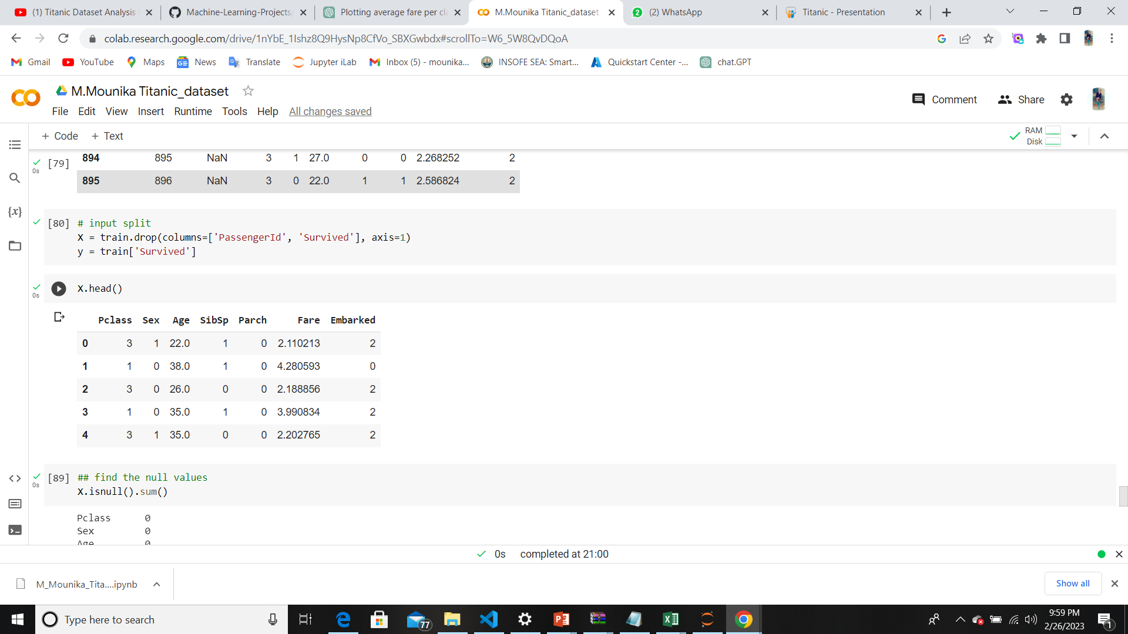
Input split
the "drop" function is used to remove the "PassengerId" and "Survived" columns from the dataframe. These columns are dropped because "PassengerId" is not a useful feature for modeling, and "Survived" is the target variable that we are trying to predict.
By splitting the input data into features and target variable, we can use X and y to train a machine learning model that can predict whether a passenger survived or not based on the given features.

Slide 22
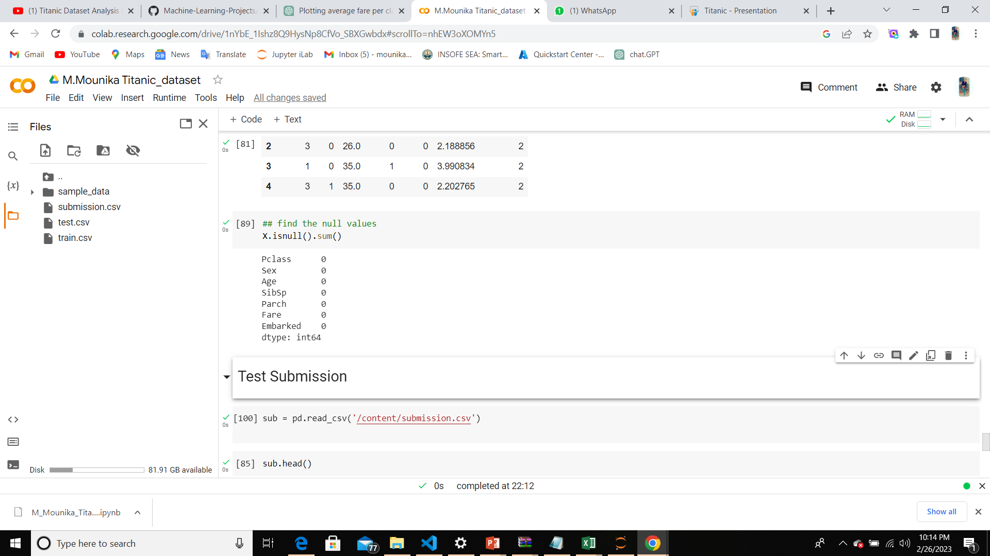
Check for null values in the features dataframe

Slide 23
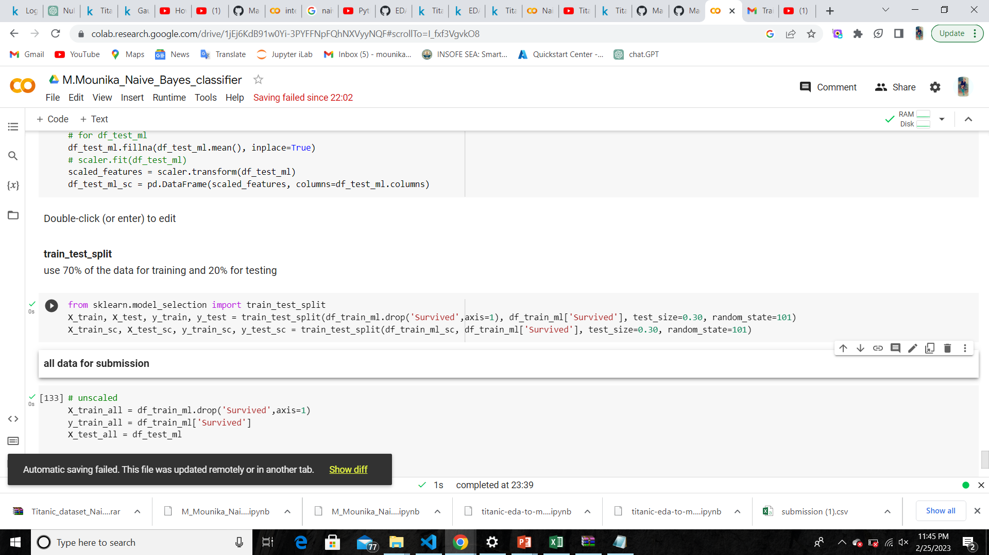
Building the model

Slide 24
Conclusion
I have removed variables like “passenger id” ,“name”, “ Ticket”, “fare”, “cabin”, as they are not effecting the target variable much .
Women , children, and first class passengers as well as people with a small family had a better chance at survival . the embarked doesn’t seem to have an effect as the percentages are in line with the amount of people embarked from each port

Slide 25


